Slide 1

DriverPass System Analysis
Kathryn Snow
Notes:
[No speaker notes required for this slide.]

Slide 2

System Requirements
The system shall create secure accounts with two-step authentication sign-in.
The system shall record all interactions by username and date.
The system will have real-time collaboration within the calendar-scheduling function.
Platform updates will be scheduled to follow the nightly updates, as necessary.
Notes:
The functional requirements are the two-step authentication and the method of tracking all inputs into system by username and date. In the initial interview Liam, the owner of DriverPass, asked to have access to the system from anywhere at any time on any device. He expressed wanting to complete control of users. The security is always important, but his need to use different devices will call for more vigilance. Liam’s request to have complete control suggests he wants to know who is doing what when. The record of use by name and date/time will provide him with a clear picture of user's behavior. The non-functional requirement of ‘performance requirements’ is described by the calendar updating in real-time and ‘adaptability’ is described in the platform updates following the nightly updates. These both focus on Liam’s request to have access to the system to look over reports.

Slide 3
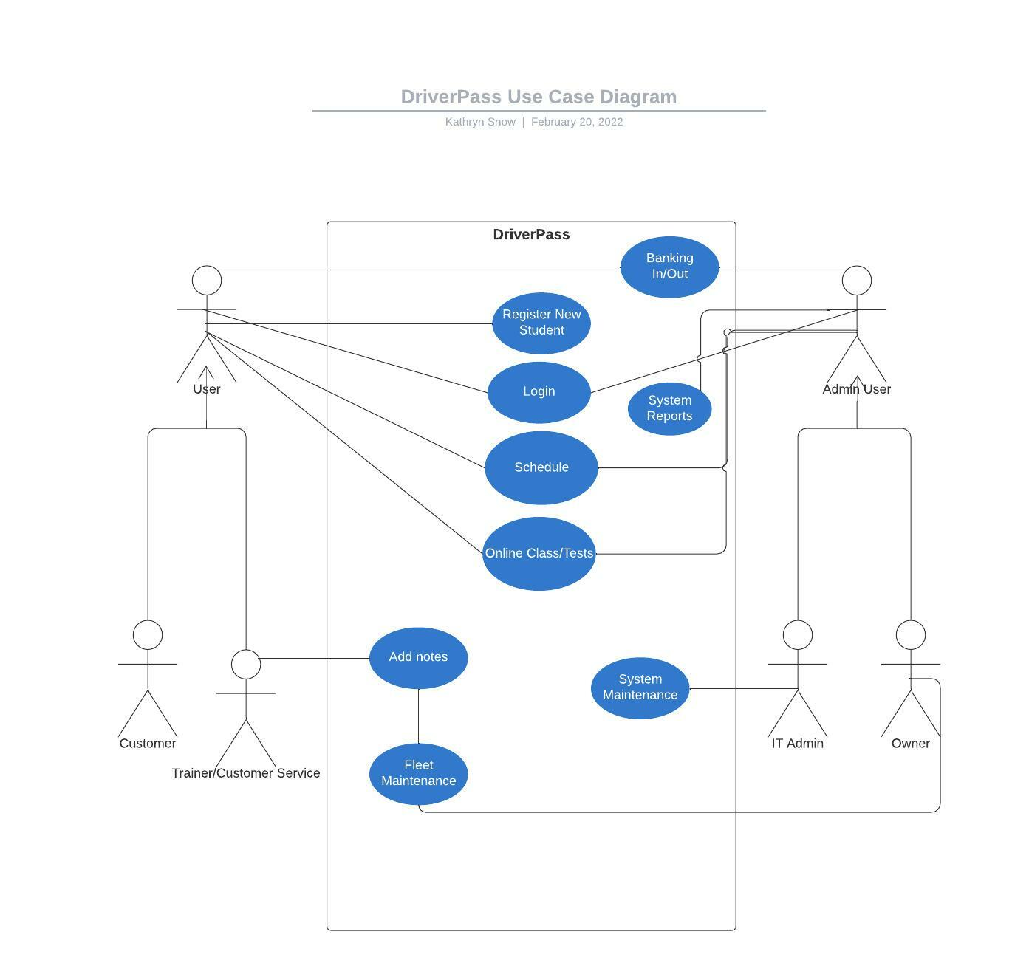
Use Case Diagram
Notes:
Here is a diagram to describe how the system will be used. On the left-hand side, you see the User. The customer and your employees are described as the users because they are inputting data into the system. For example, they are creating the student/customer file, using the schedule, taking classes and tests, and adding notes. These notes communicate special needs of the student, how the student is progressing and updating the vehicle mileage or concerns. On the right-hand side you see the Admin User. This describes your IT person and your own access. You will have access to all information and reports including the income and payouts. The IT Admin account will have access to system maintenance to limit the possibility of human error, but as owner you will have access to all accounts, so this is merely a safety net not a blockage. The Fleet maintenance will go directly to you.

Slide 4
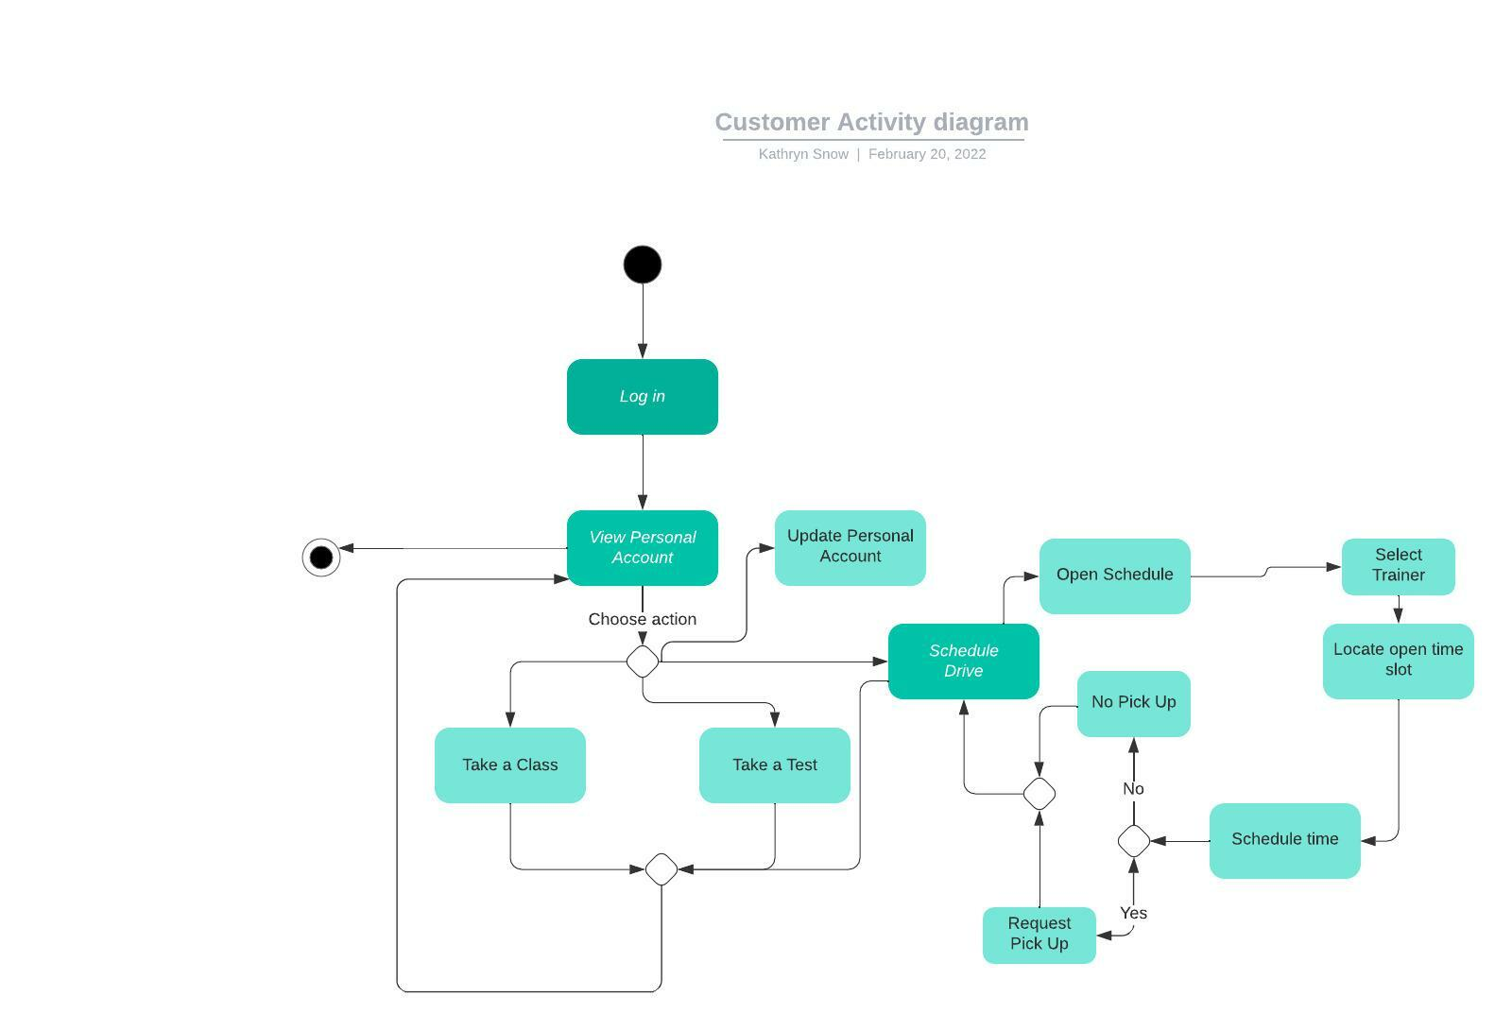
Activity Diagram
Notes:
This Activity Diagram for the customer begins at log in. Log in includes the two-step authentication so the customer safely opens their personal account which will display like your sketch outlined. The customer will see their current information displayed and will choose to take a class, take a test or schedule a drive. If they choose to take a test or take a class, they will do the activity. After they have completed it, they will return to the opening screen. If they choose to schedule a drive, they will open the calendar, locate an open time slot with their driver, select the time slot and have the choice to be picked up or not. Then they will return to their personal home screen to choose something else or log off. As requested, the driver’s notes will be in the same area as the scheduled drive calendar on their screen.

Slide 5
Security
Unique username and passwords
Two-step authentication
Limit log in attempts
Role-based access
Notes:
Security is an obvious concern in our society today. Since we use our devices everywhere at anytime it is important that we take as many precautions as possible. Knowing that the customers and indeed the business itself will be on the go, driving and not sitting at a desk while accessing the system we want to be certain to emphasize the requirement of unique usernames and passwords, two-step authentication, limited log in attempts and role-based access to each part of the system. Since the system will be cloud based it will also have the cloud’s layer of protection too. We encourage you to share with your employees the need for a secure system and request they not share their private authorization with others.

Slide 6
System Limitations
We must ensure the mobile and web-based display of the system is accounting for the difference in screen size.
We need to be aware of our time and budget which allows for some problems, but an unexpected snag could create a problem.
Notes:
As with everything we attempt to do there are limitations. We will focus on the anticipated mobile and web-based display of the system as something that is a common concern. It’s difficult to see everything on your mobile device that you see on a full screen. We will work with you to get the best look. And we have allocated time to fix unexpected problems, but it something large were to come up it could limit our system product. It’s important to mention limitations so we acknowledge thing can interfere with our project.

Slide 7
Questions?
Thank you for allowing us the time to share our system plans with you. Do you have any questions?
Notes:
Always invite questions! It gives you more insight into what they are thinking, into the political atmosphere you are presenting, and will clarify anything they missed, or you didn’t explain well enough. It could allow you to adjust plans in the moment or explain why that change would be costly, detrimental, or unfeasible.

Slide 8
THANK YOU!
You can reach us at:
ThisEmail@gmail.com
Call us at: 888-888-8888
Vist us at this website:
https://ourbusiness.hasawebsite
This Address in this Town
Zip Code
Notes:
Always thank people even if they initiated the opportunity. Remind them who you are and how to find you. If your name is in their mind when someone else talks about a similar need, you may be all they can recall.

